Slide 1
Outline of a programme plan
Aim statement
Methodology
Why this is an important issue to tackle
Scope of the projects
Impact on cost
Data on the current processes and outcome(s)
Changes Planned
Timescales
Progress against the Institute of Healthcare Improvement (IHI)’s scales
Links to other work
QI meeting times
Capacity and capability for QI

Slide 2
Outline of a programme plan
Aim
Might include focus areas
Methodology
What we are (hopefully!) teaching you – quality planning, improvement & control
Importance
Sometimes very obvious e.g. Standard
Use whatever you have
Baseline data (including experience), pareto charts, audit data, adverse events, complaints, evidence

Slide 3
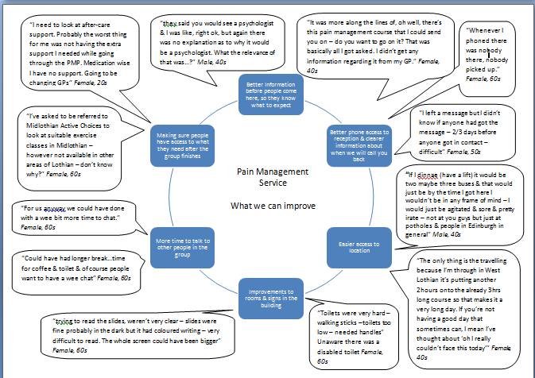

Slide 4
Clinical psychology – numbers of non-attendances (new and return patients)
April to Sept 2016 inclusive
Biggest numbers are in pain

Slide 6
Outline of a programme plan
Impact on cost/waste
How you plan to tackle this – time, more effective care, less waste
Data on current processes/outcomes
Which data do you need? Understand your processes first
Remember qualitative data too

Slide 7
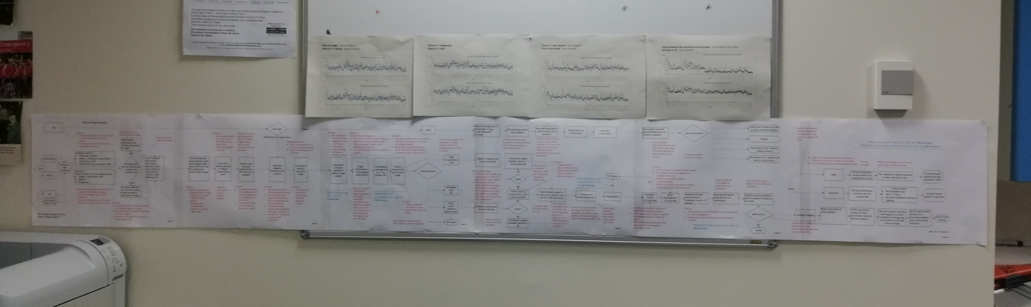
Describing your work as systems and processes...

Slide 8

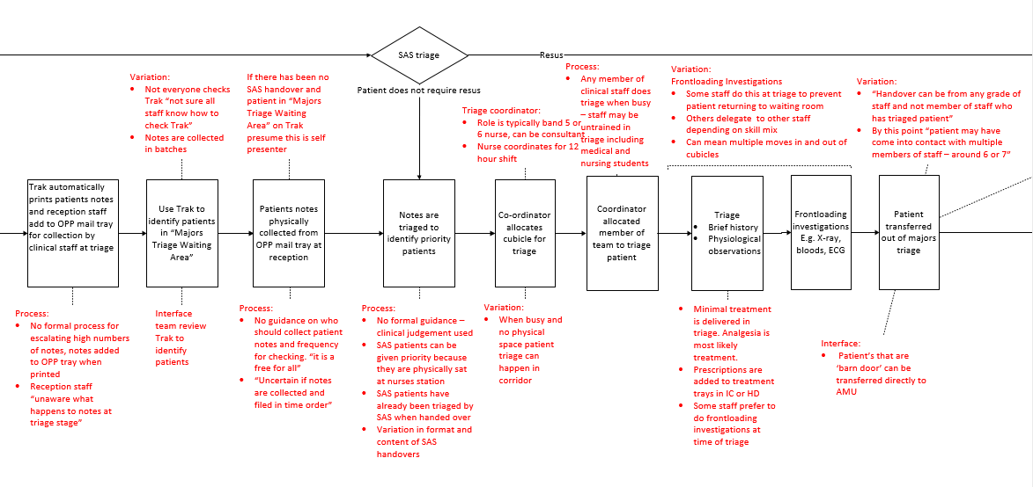
Triage

Slide 9
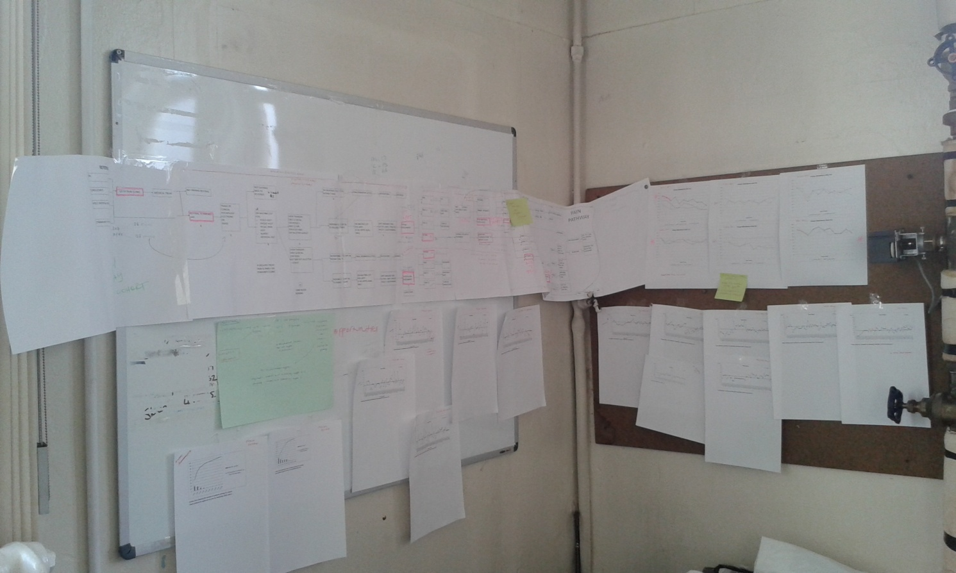

Slide 10
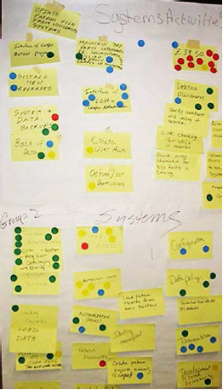
Changes planned
Prioritise
Timescales
Progress against the Institute of Healthcare Improvement (IHI)’s scales

Slide 11
Outline of a programme plan
Links to other work
E.g. Other quality programmes, SPSP, Junior doctor projects
QI meetings
When/who & how this will link into management structures
Capacity and capability for QI
SQSF, SCiL, other people who have been on the academy

Slide 12
Other stuff you need to have
Driver diagram
Measurement framework
Gantt chart?

Slide 13
Improving experience of and access to pain management services at AAH update 25th May 2017
AIM
PRIMARY DRIVERS
SECONDARY DRIVERS
CHANGE IDEAS
Improve access to psychological therapies by Reducing non attendance by 10 percentage points by 30/5/17
Patient knows & remembers about appointment
Clear letters
Reminders (text, phone)
Patient motivated to attend
Opt in
Aware of need
High quality information
‘Contracting’
Patient feels able to attend
Expectations of physical/mental health
Timing & location & mode of consultation
Patient informs us if not attending
Can contact by phone
Proactive information about non attendance
TRAK letter being changed
Improve information – health literacy
Revised patient/referrer information being tested
Trial of phone/text reminders
Testing phone reminders for “intro to group” and group session number 1
Consistent use of opt ins
done
Information improved to manage expectations
Consistent information about “intro to group”
Consistent use of DNA/CNA policy
done
Flex appt schedule
no
Test formalising phone appointments
Phone appts offered to return CNA patients
Use attendance board
no

Slide 14
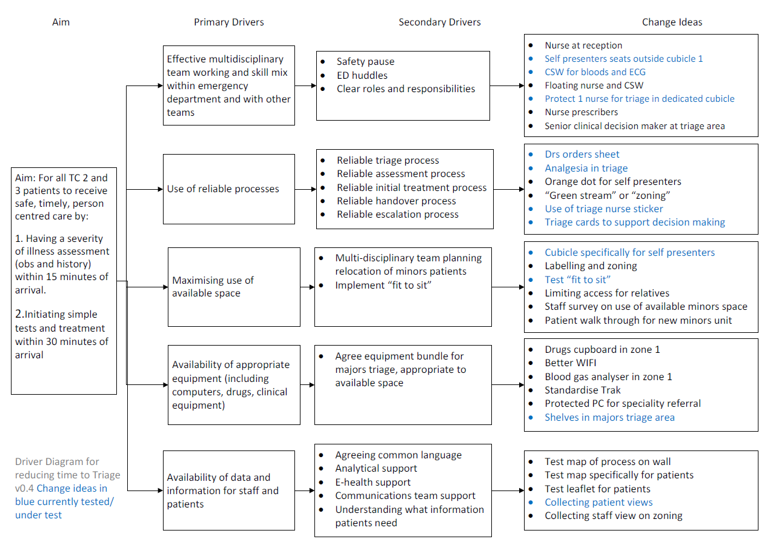

Slide 16
Measurement framework
Name of measure
Type (process/outcome/balancing)
Frequency?
Why?
Definition
Data collection
How to chart?

Slide 17
Final thoughts
Forgotten dimensions:
Patient & staff experience
Equity
Sustainability
elizabeth.bream@nhslothian.scot.nhs.uk

