Slide 1
Quality Academy Quality improvement
Driver diagram (but never tell them its a driver diagram)

Slide 2
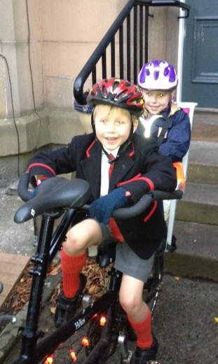
Aim
By June 2017 my kids get to school on time on 95% of days
Clear direction
population
system to improve
how much by when

Slide 3
Aim
By June 2017 my kids get to school on time on 95% of days
Leave house earlier
Calm atmosphere

Slide 4
Aim
By June 2017 my kids get to school on time on 95% of days
Get up earlier
Leave house earlier
Calm atmosphere
Reduce distractions

Slide 5
Aim
By June 2017 my kids get to school on time on 95% of days
Primary drivers
Secondary drivers
Get up earlier
Leave house earlier
Preparation night before
Calm atmosphere
Reduce distractions

Slide 6
Aim
By June 2017 my kids get to school on time on 95% of days
Primary drivers
Secondary drivers
Changes
Get up earlier
Alarm clock
Leave house earlier
Preparation night before
Make lunches
Lay out clothes
Calm atmosphere
Reduce distractions
Agree play / TV

