Slide 1
Quality Academy Presentation

Slide 2
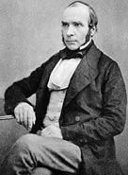

Slide 3
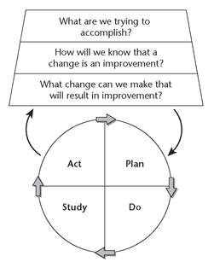
What is our theory?
What does our theory predict?
What experiment will test this prediction?

Slide 4
Humans catch cholera from microscopic ‘germs’ in contaminated water
Changing the water supply in a cholera outbreak will reduce the spread of cholera
Disable a communal water pump in a street experiencing a severe cholera outbreak and monitor the number of new cases

Slide 5
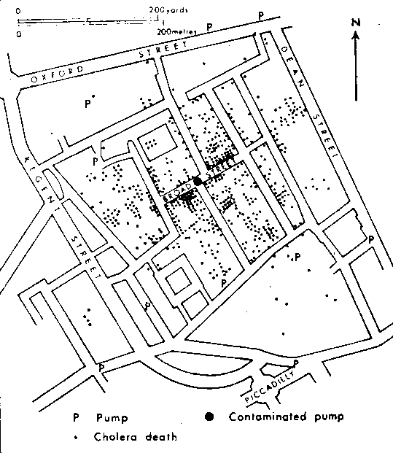

Slide 6
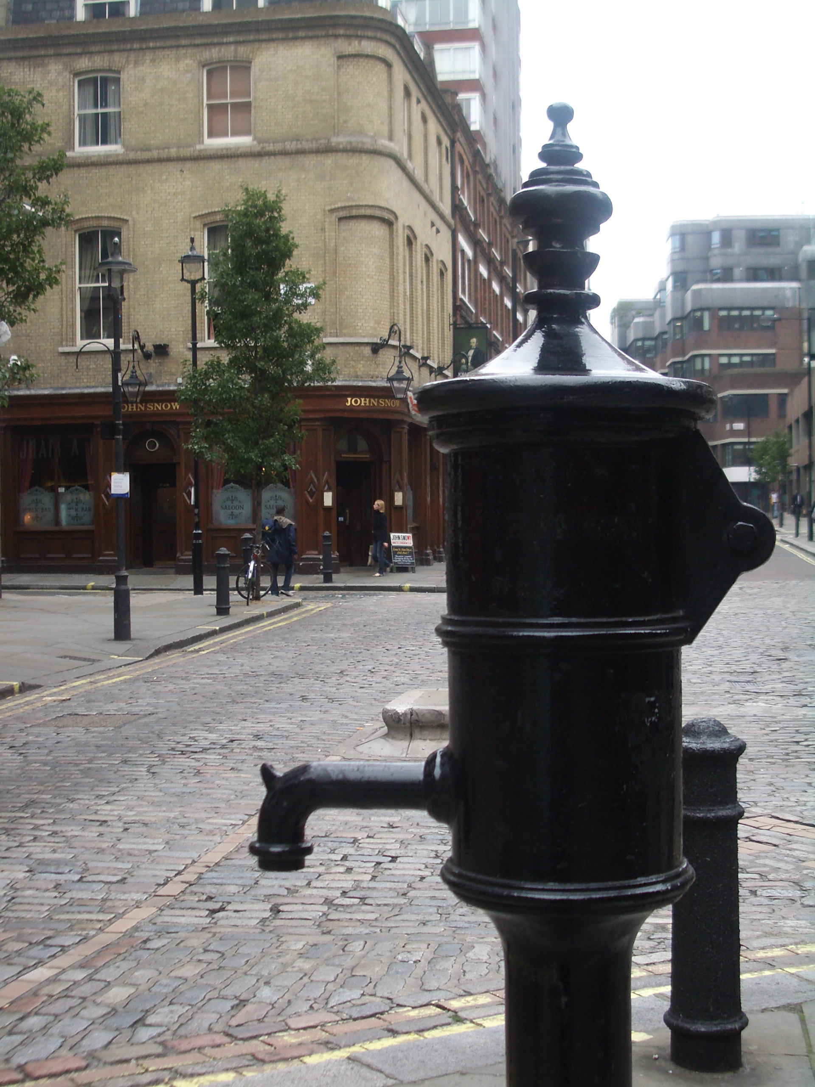

Slide 7
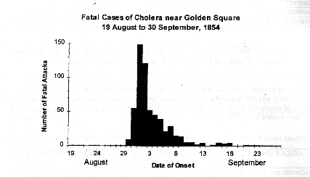

Slide 9
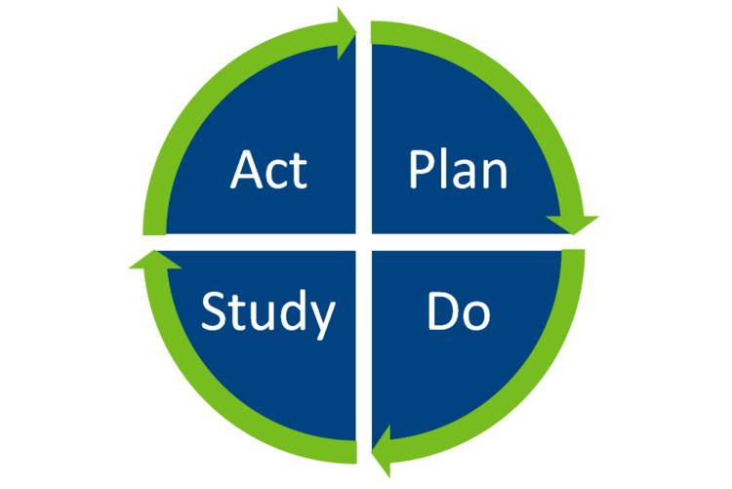
Plan-Do-Study-Act Cycles
Plan: A plan of what is to be tested including questions to be answered, predictions and answers to the questions and a plan for collection of data to answer the questions
Do: Carry out the test of change according to the plan, recording observations including unexpected outcomes/observations
Study: A comparison of the data against the predictions made in the plan and study the results
Act: Make a decision about the next course of action
Notes:
PDSA is a very structured four-step cycle which requires effort and discipline
It incorporates careful and detailed consideration of the following:

Slide 11
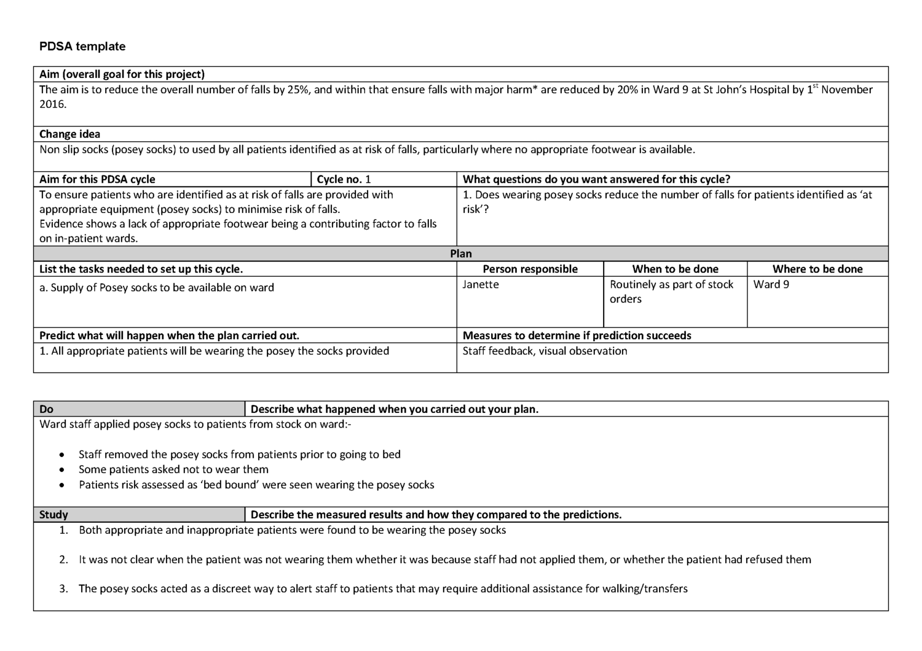

Slide 16
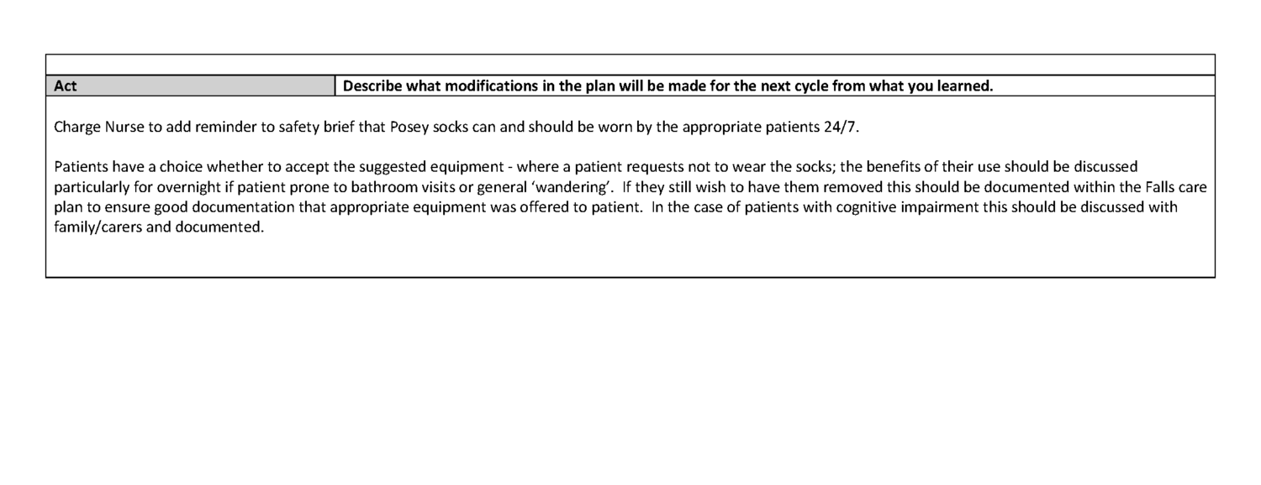

Slide 17
Exercise

