Slide 2
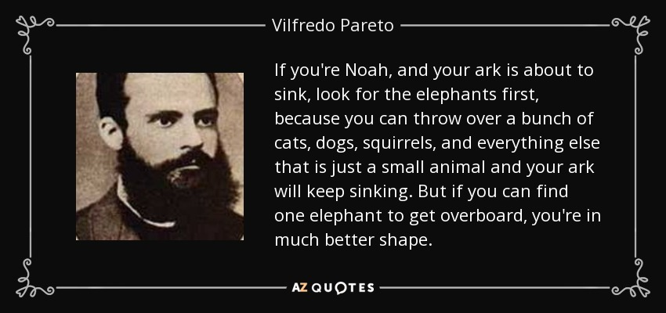
80:20 rule

Slide 3
Pareto Chart – 80:20 rule

Slide 4
Bullying and Harassment Parteo 2017- 18 Outcomes
Outcome | Total | Cum No | Cum %
No Action | 11 | 11 | 34
Facilitated Discission | 8 | 19 | 59
Disciplinary Action | 7 | 26 | 81
No formal action, informal capability management | 5 | 31 | 97
Resolved | 1 | 32 | 100

Slide 5
Process Delays By Time Bullying & Harassment

Slide 6
Comment | Count | Cum Number | Cum %
Note taking meeting arrangements | 7 | 7 | 20.00
Stressful for everyone involved | 4 | 11 | 31.43
Large amount of bullying and harassment incidents he said she said | 3 | 14 | 40.00
We get blame for delays | 3 | 17 | 48.57
Relationship with staff side | 3 | 20 | 57.14
Sick leave A/L | 3 | 23 | 65.71
Managers Expierence | 3 | 26 | 74.29
A number of investigations going on at the same time | 2 | 28 | 80.00
Cross site working | 2 | 30 | 85.71
Service in the service on AL | 1 | 31 | 88.57
Availability of investigators | 1 | 32 | 91.43
Difficult to move consultants due to specalisim | 1 | 33 | 94.29
Fractures teams | 1 | 34 | 97.14
Managers not getting back to me | 1 | 35 | 100.00

Slide 7
Pareto Staff Interviews Bullying & Harassment

Slide 8
Pareto Exercise

Slide 9
Activity Fishbone Diagram

Slide 10
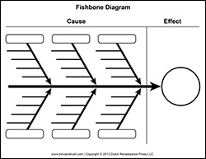
Cause and Effect Diagram
Allows a team to identify all the possible causes related to a problem.

Slide 11
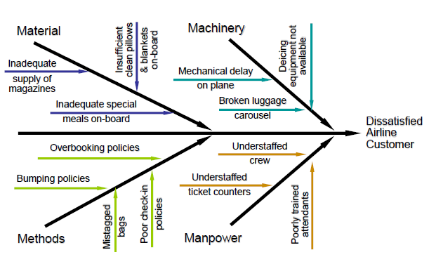

Slide 12
Management
Placement
Learn pro recruitment training
Lack of entry level posts
Managers expectations will not consider
Complete change of career
Senior managers to support redeployment
Managers responsible for training 4 weeks
Skills Matching Process
Culture expectations support mentorship
Definitions good & excellent
More specific
Assessment training centre
Pre Redeployment training
12 week training period service pays
Basic skills match
Referral forms not filled in
Input from experts
Job ready
Redeployee expectations
Support
Person Specification

Slide 13
Activity
Define the problem:
Why did I get a speeding ticket when going home on Friday night?
Brainstorm ideas
Theme
Put into diagram

Slide 14
Fish Bones
Bones – Major cause categories:
Policies – higher level decisions
Procedures – steps in the task
People – human element
Equipment
Environment – logistics and space
Measurement – data collection

Slide 15
Run Chart of ED Registration Time
Minutes to Register
MEAN
Patient Number
Notes:
Run Chart attributes
Time is plotted on the horizontal (x) axis
What you are measuring is plotted on vertical (y) axis
What processes in your department might be appropriate to look at using a run chart?
Danger with using a run chart is that every variation may seem important.

Slide 16
Run Chart
May not give you all the answers, but it well help you ask smarter questions (e.g. What happened when the registration time was much higher?)
Provides insight into process behavior (Seems like there are two processes, one group registers quickly the other more slowly.)
No statistical calculations needed
Use for any type of process and any type of data

Slide 17
Understanding Variation
Variation exists and permeates all processes. No two things are exactly alike. The problem we face is to be able to measure the extent of the variation and to establish to what degree the variation matters and to whom it matters.

Slide 18
Common and Special Cause Variation
Write the letter “a” eight times on a piece of paper using your
dominant hand.
Make all of them the same.
___ ___ ___ ___ ___ ___ ___ ___
Are they exactly the same?
Why or why not?
Notes:
Possible causes:
pen used fatigue of the writer paper caffeine level of writer smoothness of surface angle of writer's hand etc.
Would it make sense to circle one of the a 's and ask , "Why it is different?" The answer is "No!" That particular 'a' is part of a system that includes all the reasons listed above (and many others). This is called common cause variation . It is variation that is part of the system. Variation is inherent in all processes!
All work occurs in a system of interconnected processes.
Same thing if you sign your name 10 times. The variations you’ll see are common cause variations. But what if someone bumps your elbow?
Ah, something has changed…

Slide 19
Common and Special Cause Variation
Write the letter “a” three times using your
dominant hand, three times with
your other hand, then two times with
your dominant hand.
Make all of them the same.
___ ___ ___ ___ ___ ___ ___ ___
Are they the same? Why or why not?
Notes:
Which ones are obviously different? You can circle the radically different a 's and say, "Something out of the ordinary occurred here!" (The answer is that you switched your hand.) This variation is called special cause variation.
If someone bumps your elbow while you’re signing your name, no big deal, right? But what if you are a diamond cutter and someone bumps your elbow? Could be pretty expensive.

Slide 20
The dominant hand created variation because of the pen and/or paper you used, amount of coffee you’ve had, friction of your hand, etc. etc. This is common cause variation. It is inherent in the process.
Using the non-dominant hand clearly shows something very different. This is special cause—it does not always happen in the process of writing. Since it so different, you would want to ask “why”.

Slide 21
Common and Special Cause Variation
Common cause variation
is always present
Is inherent in the process
Special cause variation
In addition to common cause variation it is data that signifies the presence of a signal that needs to be investigated.
Not knowing the difference can create wasted time and effort for all.
Notes:
Common Cause Variation
Variation that is inherent in the process. […design of the process]
It is produced by the interactions among the variables of the process.
This collection of variables and their interaction is called the system of common causes.
Special Cause Variation
Variation in the process that is assignable to a specific cause or causes.
This variation arises because of special circumstances.
Failure to understand the difference can actually increase variation in a system.

Slide 22
Actions to Take
Common Cause
Recognize the variability inherent in the process
Responding to this variation is a waste of time
However, the more variation the lower the reliability
To change the results, change the process
Special Cause
Differentiate from common cause variation (rules exist for this)
Find out what happened
Eliminate or minimize the impact if negative
Build positive impact into process
Notes:
Changing the process is moving the middle line…
Actions to avoid:
Tampering or responding to change in a process and taking action without understanding the nature of the variation in the process.
Doing nothing at all.
Making fundamental changes in the process. (without the understanding)

Slide 23
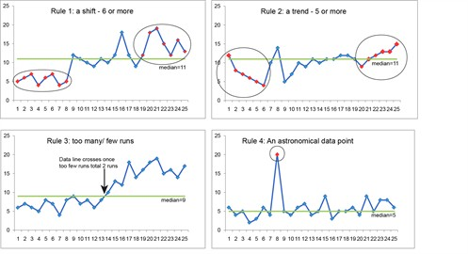
Run Chart Rules

