Slide 1
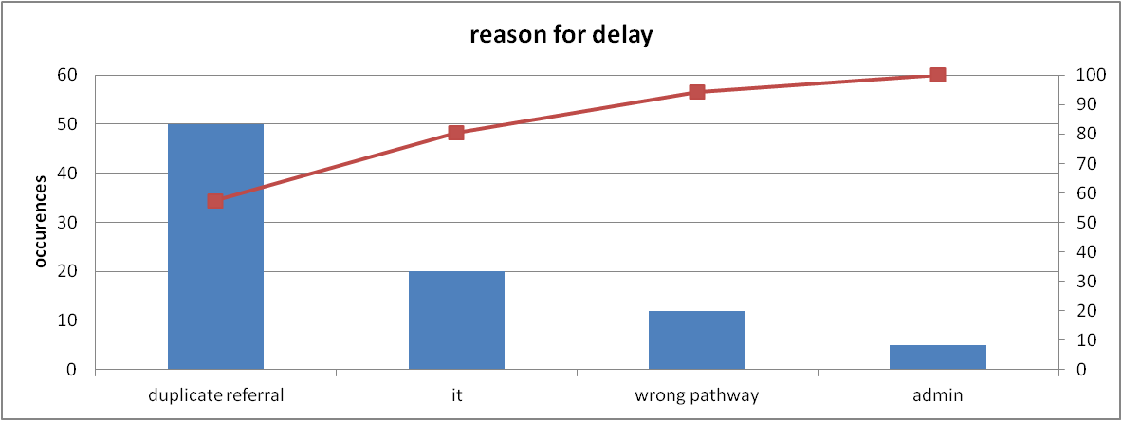
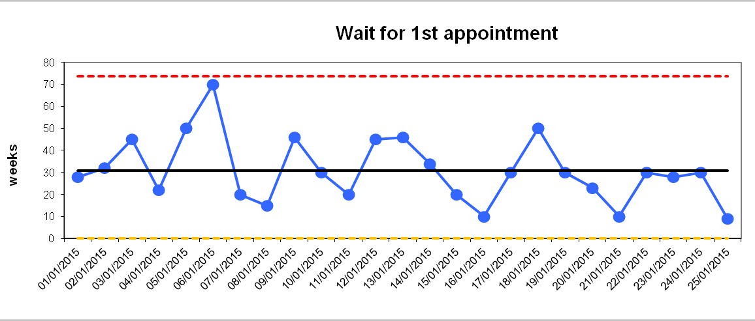
PROJECT
Project team names
Mission Statement
Describe the core purpose of your service area. Why is this work important?
Process map
Process 1
Process 2
Process 3
Process 4
Process 1
Data used to understand system
Share your data and other evidence which illustrated how well the mapped process above is working and where there is variation in your system
Quality Challenges
Describe the quality challenges which you identified. How did you work with your team members to identify these? How will you prioritise areas for improvement?
Aim for Future Quality Improvement
Describe the specific aim for future QI work in your service area. Indicate & outline your planned next steps. Have you identified who will lead the completion of your Quality Plan and who will be responsible for the Implementation of the Quality Plan

