Slide 1
My Quality Improvement Journey
Debbie Crerar
Clinical Lead Physiotherapist
Midlothian
September 2018

Slide 2
About me
Physiotherapist
Graduated 2001
First job as a Junior Physiotherapist at Borders General Hospital in 2001
Moved to work in Dr Grays Hospital in Elgin in 2002 – worked my way up through the different grades and was appointed to interim Lead MSK Physiotherapist for Moray
Started in NHS Lothian in 2008, as Team Lead Physiotherapist at Tollcross Health Centre
2013 – went on maternity leave

Slide 3
I felt…
Disillusioned
Frustrated
A lack of career progression
A lack of personal development
It was difficult to get my voice heard
It was difficult to influence decisions
Like we were constantly firefighting
Staff morale was low
My job was no longer the job it once was
Did I even want to be a Physiotherapist any more?

Slide 4
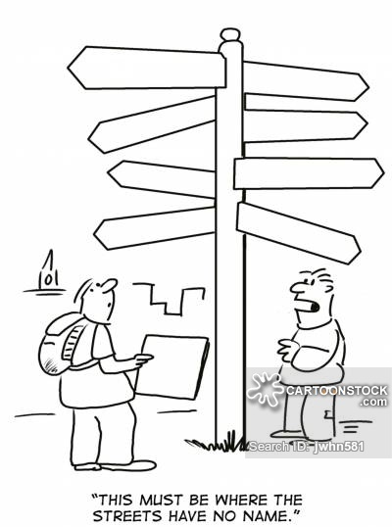
Something had to change…
I just didn’t know what…

Slide 5
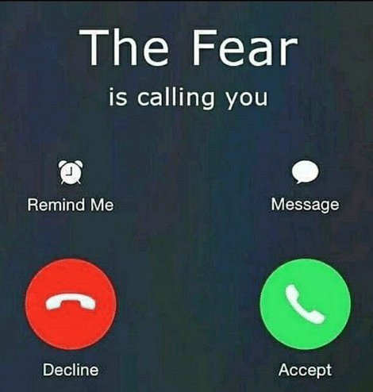
Or how to do it…
…without succumbing to the fear?

Slide 6
But I had a year to forget about it all!

Slide 7
Delivering Leadership Excellence
Completed 2014-2015
Project Topic:
Scoping Quality Improvement Knowledge in AHPs
an introduction to QI, a chance to network with other AHPs, time away from the old routine, good conversation skills, data collecting skills, influencing skills, leadership skills, project working, how to tweet… and so much more…

Slide 8
An opportunity to influence change…
…in a structured way.

Slide 9
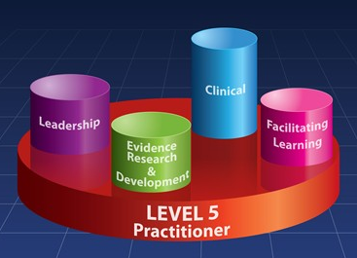
NES Career Fellowship
Completed 2015-2016
Project Topic:
Increasing QI knowledge in AHPs
funding applications, further QI skills, using data, project working, more leadership skills, teaching and sharing knowledge, understanding others, using QI tools, embedding QI within my workplace… and so much more…

Slide 11
NHS Lothian AHP QI Steering Group Member
2016-present
Looking at how we embed and spread QI knowledge across AHPs in NHS Lothian
This group used our DLE and Career Fellowship projects as direction for it’s work… we were starting to influence change!

Slide 12
CSP Scotland Board Representative
2016-2018
public speaking, networking nationally, organising and attending national events, a greater understanding of strategy and government influences, a chance to influence policy and strategy, the chance to develop project ideas which I couldn’t develop within my clinical role, better communication skills, the chance to learn from colleagues, greater knowledge of what was happening within my profession, the ability to influence change both locally and nationally, the skills to have a better conversation with my manager, leadership skills… and so much more!

Slide 13
QI Skills Course
Competed in 2017
Project Topic:
Reducing waiting times in MSK Physiotherapy

Slide 14
Our Aim Statement

Slide 15
What happened?
We gathered data and plotted it – showing a steady increase in waiting times over the preceding months.
We came up with lots of ideas of things we could change.
We drew out our process map to help understand our system.
We learned lots from our AHP colleagues.

Slide 16
What we found
We found huge amounts of unwarranted variation that needed addressed.
We learned very quickly that we did not understand our system as well as we thought we did.
We needed to invest in staff training
We were not in a position to try out any change ideas yet…

Slide 17
A Quality Improvement Approach
Gave me the opportunity to tackle many of the things I was frustrated with in a systematic way.
It allowed me to communicate with my manager in a way I hadn’t been able to before.
It taught us very quickly that the change we thought needed to happen is not necessarily the right thing to change!
The importance of reducing unwarranted variation became very, very apparent very quickly!
We realised that a huge upskilling of staff was needed.
It taught us the importance of understanding our system and processes.
QI gave us the skills to make small, systematic changes to the system.
It gave us permission to try things out – and use the data to influence whether to continue with something or whether to try something else instead.

Slide 18
Either influence the decision maker, be the decision maker or find ways to change your financial envelope.
Carl Davies, Commissioning Manager, Gloucestershire

Slide 19
What happened next?
January 2018 - I was appointed to Clinical Lead Physiotherapist for Midlothian
April 2018 – started clinics in 3 GP practices whereby Advanced Practice Physiotherapists are working as an alternative to a GP using QI approaches to tweak and develop the service
June 2018 – I started managing the Midlothian MSK Physiotherapy service with 50% clinical staff vacancies, no administrative support, incredibly low staff morale and a 39 week waiting list

Slide 20
September 2018
No vacancies in Midlothian MSK Physiotherapy
Our admin support is in place and being trained
The waiting list for Midlothian MSK Physiotherapy is coming down and expected to be keep reducing
Staff morale within MSK Physiotherapy is improving all the time

Slide 21
Over 1000 patients have been able to access Physiotherapy advice, exercise and self management strategies in less than a week from phoning the GP surgery (most have accessed within 48 hours)
We have expanded our Advanced Practice Physiotherapy Service to 5 GP practices – and are due to start in another two GP practices within the coming months
We have accessed additional funding for equipment, upgrading departments and training by providing data, project plans and using QI approaches

Slide 22
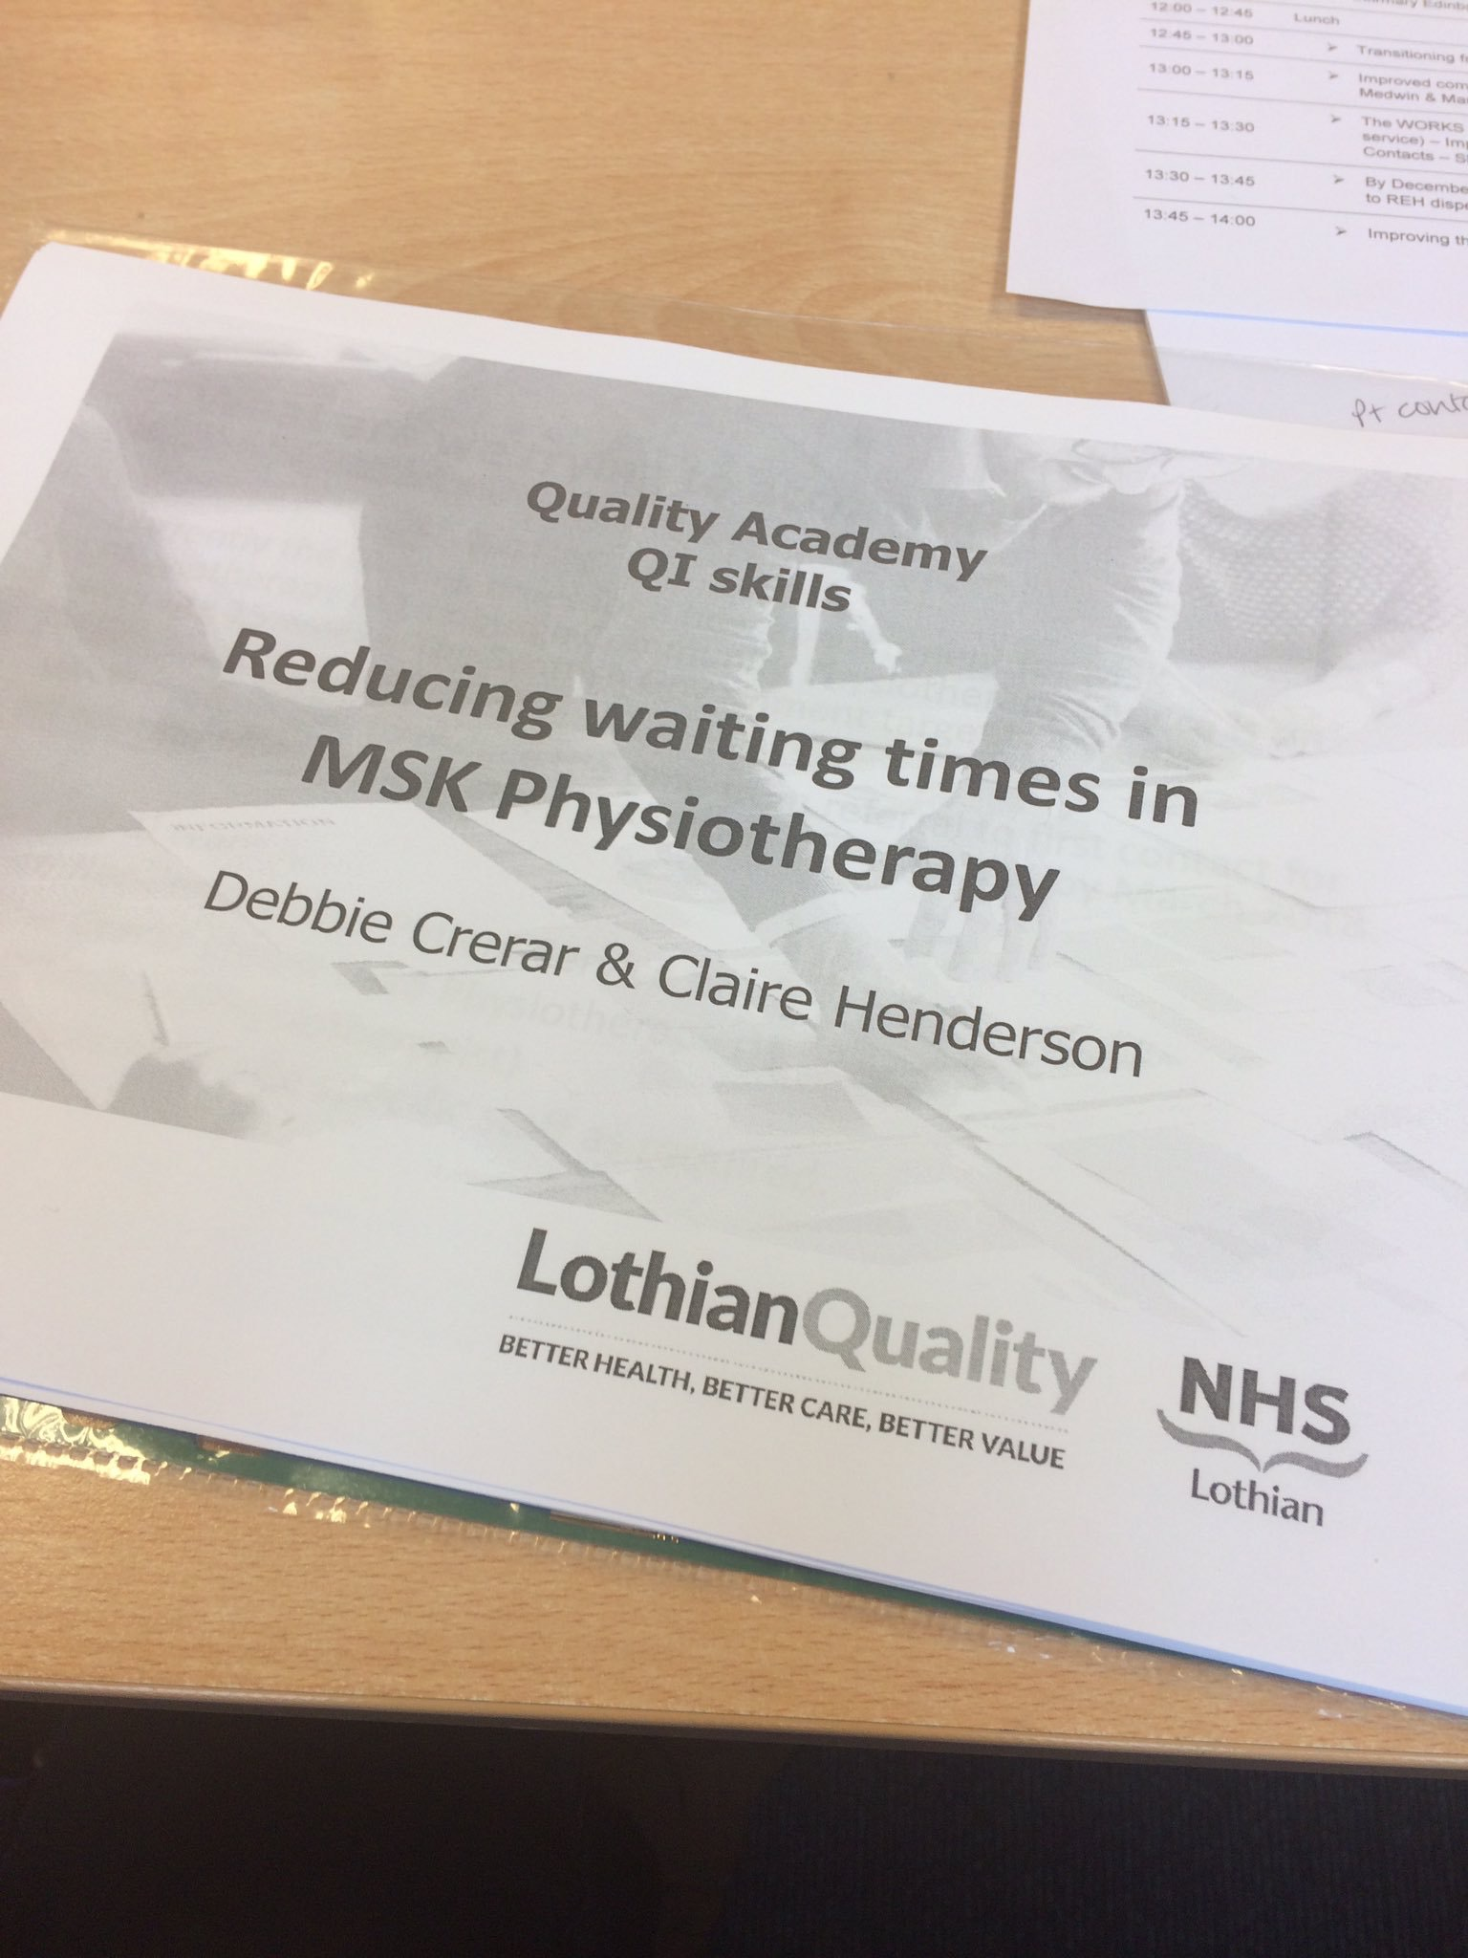
They reduced the variation, invested in the staff and waiting times have started to come down… this work has been taken on by someone else as part of an ongoing QI approach to reducing waiting times.

