Slide 1
Equalities & Human Rights NHS Lothian’s Approach 2019
Chris Bruce
Lead on Equality and Human Rights
Notes:
Access
Everyone who comes to one of our buildings, or gets in touch with us, will feel welcomed. We will talk about what matters to them, and help if we can.
Compassion
All of our interactions with each other, and with people who use our services, families, and communities, will be underpinned by compassion. That includes our approach to leadership. See our Staff Experience and Engagement Strategy,
Participation
“Nothing about us without us”. The starting point of any rights based approach is to hear the voice of people who will be affected by what happens. We need to re-build our infrastructure and approach to make sure this can happen, every time, in a proportionate and effective way.
Justice
We will seek equity in all of our work. To make the best use of our limited resources, we will demonstrate that we have invested in upstream working wherever we have been able to re-work what we do. We will seek to understand who is using our services, who is working in them, and their impact. We will shine a light on the inequalities, and remove them.
Link with NHS Lothian values
Quality | Dignity and Respect | Care and Compassion | Openness, Honesty and Responsibility | Teamwork
Links with other local public bodies

Slide 2
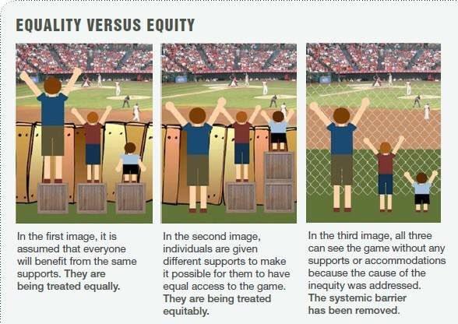
CECHR City for All Women Initiative (CAWI), Ottawa
Notes:
Ottawa women’s beautiful cartoon

Slide 3
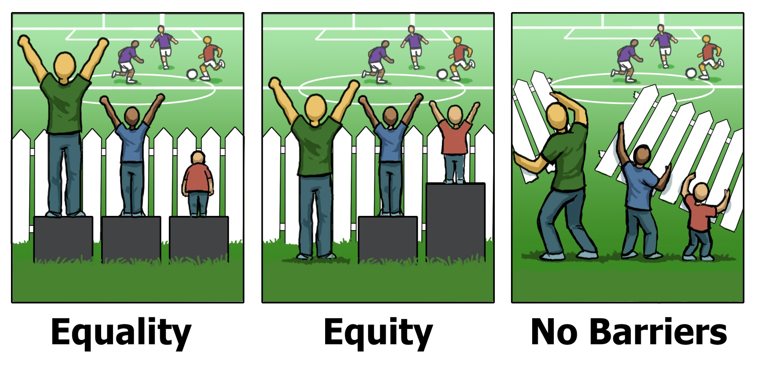
CECHR City for All Women Initiative (CAWI), Ottawa
Notes:
Ottawa women’s beautiful cartoon

Slide 4
What we heard; four equality outcomes
Access
Compassion
Participation
Justice
Notes:
Access
Everyone who comes to one of our buildings, or gets in touch with us, will feel welcomed. We will talk about what matters to them, and help if we can.
Compassion
All of our interactions with each other, and with people who use our services, families, and communities, will be underpinned by compassion. That includes our approach to leadership. See our Staff Experience and Engagement Strategy,
Participation
“Nothing about us without us”. The starting point of any rights based approach is to hear the voice of people who will be affected by what happens. We need to re-build our infrastructure and approach to make sure this can happen, every time, in a proportionate and effective way.
Justice
We will seek equity in all of our work. To make the best use of our limited resources, we will demonstrate that we have invested in upstream working wherever we have been able to re-work what we do. We will seek to understand who is using our services, who is working in them, and their impact. We will shine a light on the inequalities, and remove them.
Link with NHS Lothian values
Quality | Dignity and Respect | Care and Compassion | Openness, Honesty and Responsibility | Teamwork
Links with other local public bodies

Slide 5
Four equality outcomes – put another way
How I get in
What I can give & get
Who I can be
< e q u i t y >

Slide 6
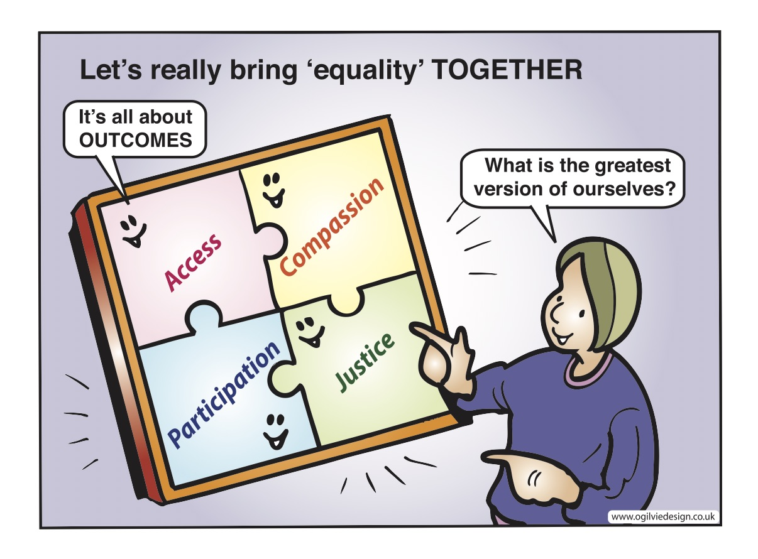
What we heard; four equality outcomes
Access
Compassion
Participation
Justice

Slide 7
Arnstein, Sherry R.(1969)
'A Ladder Of Citizen Participation'
Notes:
Sherry Arnstein’s Ladder of Engagement and Participation

Slide 8
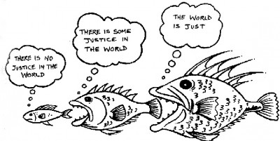
Recent EHRC research on public attitudes to Rights

Slide 9
Organise!

